Slide 1








Lesson 1. Angular Services

Slide 2
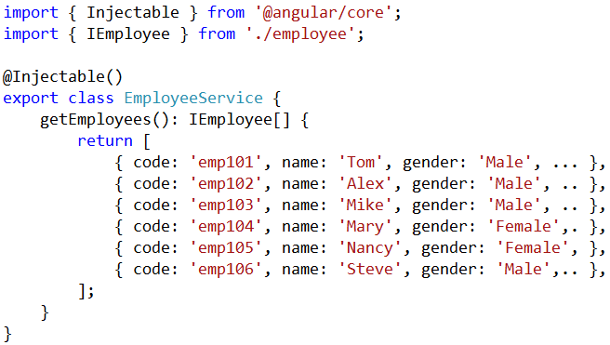
Angular Services Tutorial
Why do we need a service in Angular
A Service in Angular is generally used when you need to reuse data or logic across multiple components

Slide 3
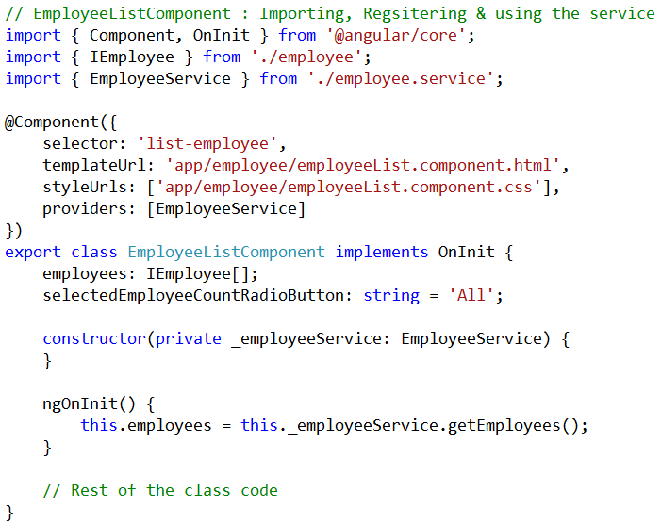
Angular Services Tutorial

Slide 4
Q & A
Contact:rashmipawaskar@synergetics-india.com

Slide 5
Thank You

